Slide 1

Non-negative Matrix Factorization (NMF) for Multiomics Data
Tutorial VT1 – A Hands-on Introduction with NMF
Loni Taylor
ISCB-Africa ASBCB 2025

Slide 2



What is NMF?
Non-negative Matrix Factorization is a dimensionality reduction technique that factorizes a matrix into two lower-dimensional matrices with non-negative entries.
$$≈$$
$$×$$
Notes:
It is particularly useful for extracting latent features from data, where the underlying factors are assumed to be non-negative (i.e., all data points are positive or zero).

Slide 3
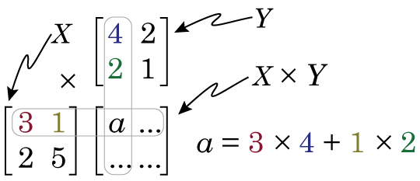
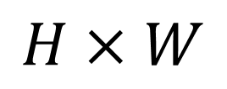

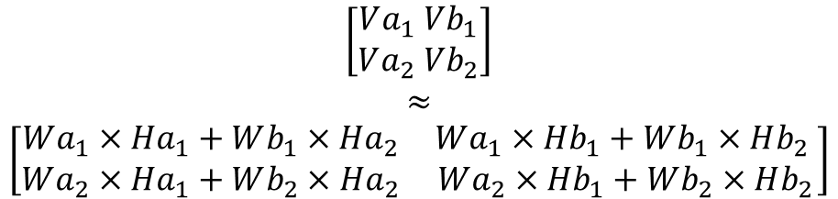

How NMF Works: Assumptions
$$V ≈W ×H$$
$$\left[\begin{aligned}Va_{1} Vb_{1} \\ Va_{2} Vb_{2}\end{aligned}\right]$$
$$≈$$
$$\left[\begin{matrix}Wa_{1}×Ha_{1}+Wb_{1}×Ha_{2} & Wa_{1}×Hb_{1}+Wb_{1}×Hb_{2} \\ Wa_{2}×Ha_{1}+Wb_{2}×Ha_{2} & Wa_{2}×Hb_{1}+Wb_{2}×Hb_{2}\end{matrix}\right]$$
$$≠$$
$$H×W$$
Traditional Matrix Multiplication*
*https://www.billconnelly.net/?p=534
Notes:
Factorization: NMF works by factorizing a non-negative matrix 𝑉 into two smaller non-negative matrices 𝑊 and 𝐻, such that:
𝑉 ≈ 𝑊 × 𝐻
𝑉 is the original data matrix (for example, gene expression values or document-term matrix).
𝑊 contains the "basis" or "components," often interpreted as the features or patterns.
𝐻 contains the "coefficients" or "activations," showing how strongly each component is present in the original data.

Slide 4
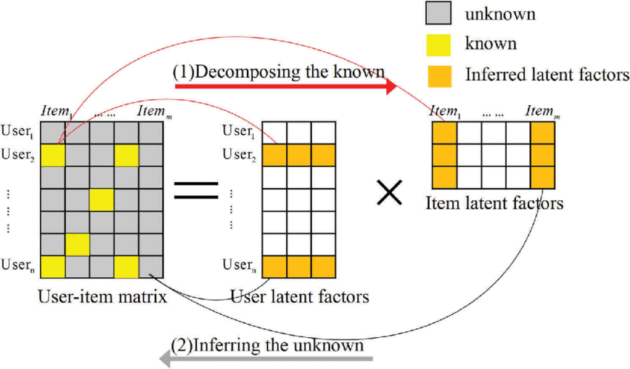
How NMF Works: Matrix Decomposition*
W
H
V
https://www.researchgate.net/profile/Jun-Xu-67/publication/321344494/figure/fig1/AS:702109309751298@1544407312766/Diagram-of-matrix-factorization.png
Notes:
Factorization: NMF works by factorizing a non-negative matrix 𝑉 into two smaller non-negative matrices 𝑊 and 𝐻, such that:
𝑉 ≈ 𝑊 × 𝐻
𝑉 is the original data matrix (for example, gene expression values or document-term matrix).
𝑊 contains the "basis" or "components," often interpreted as the features or patterns.
𝐻 contains the "coefficients" or "activations," showing how strongly each component is present in the original data.
Decomposes data into interpretable latent factors
Captures co-expressed genes/proteins/metabolites
Useful for clustering and feature selection

Slide 5
Why NMF for Multiomics?
NMF helps identify hidden factors
Reducing the complexity of multiomics data
NMF can be used to identify gene expression patterns associated with disease, protein complexes in cellular networks, and metabolic pathways in diseases.
Effective data integration
Precision medicine
Notes:
: Customizing treatment based on individual genetic and molecular profiles.
Traditional Limitations: Single-omics data often overlook critical disease mechanisms and differential expressions.
Multi-Omics Integration: Offers a holistic view for more precise disease understanding.^{[8]}

Slide 6
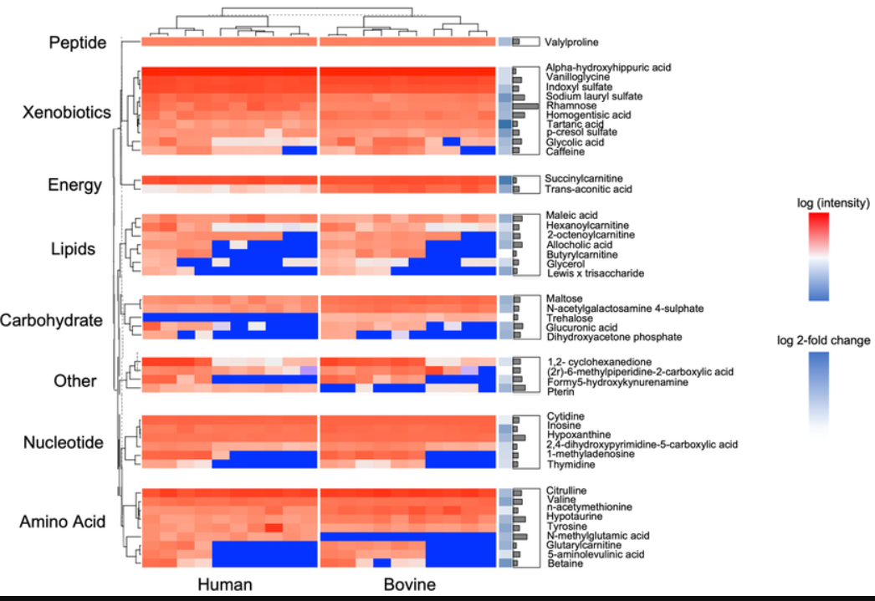
NMF for Biomarker Discovery
Finding Biomarkers with NMF
Identify top features in NMF components
Cluster samples by shared profiles
Use output for prediction or pathway analysis
Untargeted Metabolomic Analysis of Lactation-Stage-Matched Human and Bovine Milk Samples at 2 Weeks Postnatal
Notes:
Lemas, Dominick & Du, Xinsong & Dado-Senn, Bethany & Xu, Ke & Dobrowolski, Amanda & Carvalho Magalhães, Marina & Aristizabal-Henao, Juan & Young, Bridget & Francois, Magda & Thompson, Lindsay & Parker, Leslie & Neu, Josef & Laporta, Jimena & Misra, Biswapriya & Wane, Ismael & Samaan, Samih & Garrett, Timothy. (2023). Untargeted Metabolomic Analysis of Lactation-Stage-Matched Human and Bovine Milk Samples at 2 Weeks Postnatal. Nutrients. 15. 3768. 10.3390/nu15173768.

Slide 7
Limitations
Data Quality Variability: Platform and sample type inconsistencies.
Computational Complexity: Handling high-dimensional data requires optimization.
Disease Focus: Omics factors for cancer and MS datasets are available; validation for other diseases needed.

Slide 8

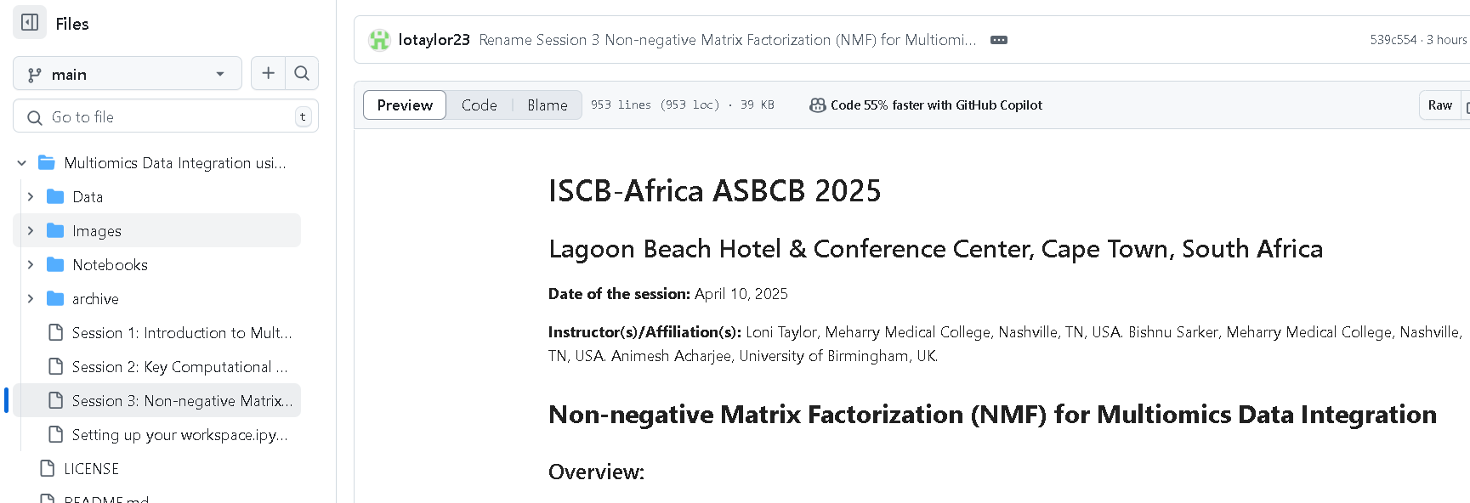
Hands-On Tools & Demonstration
Tools: Python, pandas, scikit-learn, numpy
Code notebook: Session 3: Non-negative Matrix Factorization (NMF) for Multiomics Data.ipynb
Notes:
https://github.com/lotaylor23/tutorials/blob/main/Multiomics%20Data%20Integration%20using%20Graph%20Based%20Machine%20Learning/Session%203%3A%20Non-negative%20Matrix%20Factorization%20(NMF)%20for%20Multiomics%20Data.ipynb

Slide 9
Conclusion
Key Takeaway:
Dimensionality Reduction: Simplify complex multiomics datasets by focusing on the most important components.
Uncover hidden biological patterns across multiple omic layers, such as common pathways or gene-metabolite interactions.
Could lead to more accurate clinical risk predictions and identification of novel biomarkers.
Ability to feed biomarkers into a prediction model after applying NMF, the new features would be used as the input features for the machine learning model

Slide 10
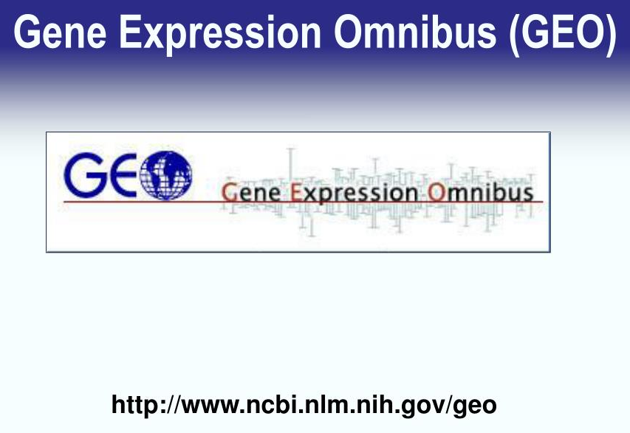


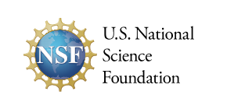






Acknowledgements
L’OMAR Lab Team

Slide 11
Q&A

